Slide 1

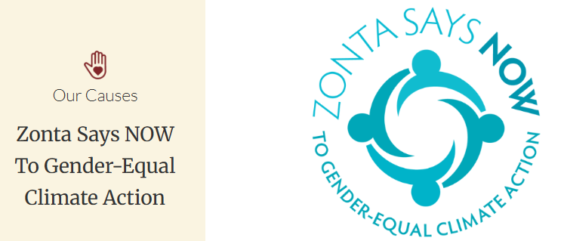

Slide 2
During climate-related disasters, women are more likely to be injured or killed, lose their job, or be forced into slavery or prostitution to survive.
With each climate-related disaster, women fall farther behind men. Women are less able to rebuild their lives due to the widening gender gaps in education, pay, legal rights, leadership, and societal responses to climate change.
https://www.zonta.org/Web/Web/Causes/Climate_Justice.aspx?hkey=bda8d92c-578a-4497-bf77-695ec0376e5a
Renuka Gamage - Zonta Club of Ottawa CANADA

Slide 3

Historical and structural gender inequalities
to LEAD
to ACT
to Advance SOLUTIONS
to DECIDE
to Reduce BARRIERS
Having fewer resources and choices
Renuka Gamage - Zonta Club of Ottawa CANADA

Slide 4
FACT
UNFPA Climate Empower project
estimated 80% of people displaced by climate change are women
FACT
World Bank’s 2021 Groundswell report
By 2050, climate change could force up to 216 million people to move within their countries
FACT
World Resources Institute
in sub-Saharan Africa where 600 million people still lack access to electricity, women manage the household energy choices and have higher insight into how to protect and use their resources and finances
Renuka Gamage - Zonta Club of Ottawa CANADA

Slide 5
FACT
UNFPA Climate Empower project
Climate change could force at least 12.5 million girls each year in 30 low- and lower-middle-income countries to abandon their education, with 22 of these countries located in Africa
FACT
UN Foundation
Just 3% of philanthropic environmental funding supports girls’ and women’s environmental activism.
FACT
UNFPA Climate Empower project
If average temperatures were to increase by just 1°C, women would face a staggering 34% greater loss in their total incomes compared to men.
Renuka Gamage - Zonta Club of Ottawa CANADA

Slide 6
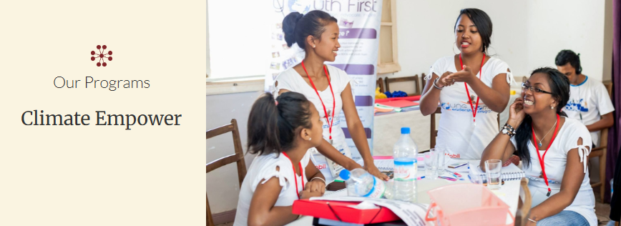
The Climate Empower: Community Empowerment and Innovation for Gender-Transformative Climate Action program hopes to strengthen women and girls’ role as agents of change for climate resilience.
Zonta International has committed US$1,000,000 to the UNFPA program: Climate Empower
Strengthening women and girls as agents of change
knowledge of the impacts of climate change and crises on GBV
Training to identify and initiate solutions to build resilience
Entrepreneurship to empower vulnerable and left behind populations
Story telling to demonstrate the role of innovation as a catalyst in preventing climate induced GBV and harmful practices
Renuka Gamage - Zonta Club of Ottawa CANADA

Slide 7
Zonta Says NOW to Gender-Equal Climate Action is Zonta International’s global initiative to achieve gender-equal climate justice.
https://www.zonta.org/ZontaSaysNOW
- Zonta members advocate for women’s full and equal participation in the economy and support their inclusion as decisionmakers on environmental sustainability at national and local levels.
Renuka Gamage - Zonta Club of Ottawa CANADA

Slide 8
Zonta International calls on governments to:
Sign the Paris Agreement and uphold the principles of climate justice agreed to
Actively consider human rights, gender equality and empowerment of women and girls in defining and implementing their national climate action plans
Set up more gender-balanced governing bodies to integrate gender-sensitive climate change measures
Arrange education for girls and support girls’ access to education
Include basic education on climate change and its consequences to nature and societies for all students
Ensure climate adaptation and mitigation plans address the unique needs of women and barriers to women’s full participation in the economy,
Include women in the formation of disaster preparedness and response plans
Renuka Gamage - Zonta Club of Ottawa CANADA

Slide 9
Zonta International calls on its membership to:
Increase their awareness of climate change and its gender-related consequences and raise awareness locally
Include gendered climate change advocacy actions in their advocacy plans
Support the inclusion of women at the national and local tables of decision-makers on environmental sustainability
Promote girls’ education, the inclusion of climate literacy in schools, and girls’ participation in STEM studies to increase gendered scientific and technical contributions to climate change mitigation
Advocate for national policies that consider women’s economic opportunities and ensure their full and equal participation in the economy
Zonta Says NOW Action Guides and the Framework for Action
Renuka Gamage - Zonta Club of Ottawa CANADA

